Slide 1
Software Defined Networking
(SDN)
Reference Book:-
William Stallings, Foundations of Modern Networking: SDN, NFV, QoE, IoT and Cloud
Presented by:-
Shivam Yadav (42)
Vani Tyagi (49)
Nasreen Parween (58)
Riya Tyagi (60)

Slide 2
INDEX
Introduction
SDN Concept
SDN Approach
SDN Architecture
SDN- and NFV-Related Standards
SDN Data Plane
OpenFlow Logical Network Device
SDN Control Plane Architecture
SDN Controller APIs
Routing in SDN Networks

Slide 3
Introduction
→ What is SDN?
stands for Software-Defined Networking (SDN)
a networking paradigm that decouples the control plane (which makes decisions about where traffic is sent) from the data plane (which forwards traffic to the selected destination).
an approach to computer networking that allows network administrators to programmatically initialize, control, change, and manage network behavior dynamically via open interfaces and provide abstraction of lower-level functionality.
Key Objectives of SDN :
Separate the control and data planes.
Centralized network control to gain a global view of the network.
Enable programmability of the network via open APIs.
Promote vendor-neutral and open standards (e.g., OpenFlow).
Increase agility and simplify management in complex networks.

Slide 4
Why do we need SDN?
Traditional networks are hard to manage
Each network device (like routers and switches) needs to be configured separately.
his takes a lot of time and effort, especially in large networks.
Slow to adapt to changes
Adding new services or changing the network setup requires manual work.
It slows down how fast businesses can react to new needs or problems.
Lack of flexibility
Traditional networks are built using fixed rules and hardware.
They can’t easily adjust to new traffic demands or technologies.
No central control
Each device makes its own decisions.
There’s no overall view of the entire network, which makes troubleshooting and optimization difficult.
5. Too many complex protocols
Different devices use different communication methods (protocols).
This causes compatibility issues, especially when using equipment from different vendors.

Slide 5
6. Separation of Control and Data Planes
Traditional networks tightly couple forwarding (data) and control logic.
SDN separates these layers, allowing independent evolution and better manageability.
This centralized control enables smarter, consistent decision-making across the network.
7. Network Programmability
SDN provides programmable APIs for developers to customize how the network behaves.
Applications can: Control traffic flows dynamically, Deploy security rules, Prioritize bandwidth for critical services.
Simplifies upgrades and integration with virtualized/cloud environments.
8. Cost Reduction
By using commodity (white-box) hardware, organizations avoid vendor lock-in.
Simplifies hardware needs and reduces operational costs.
Easier automation means less need for manual work.

Slide 6
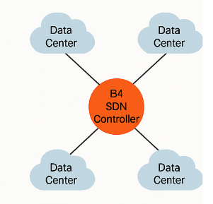
SDN Example: Google (that moved from a traditional network setup to a Software-Defined Networking (SDN) approach)
-> The Problem (Before SDN)
Google’s data centers handle millions of search queries, emails, videos, and more—every second.
They used traditional networking, where each device (router, switch) worked independently.
Managing these massive, global networks with manual configurations was: - Slow - Hard to scale - Prone to errors - Couldn’t respond quickly to changing traffic demands
-> The Shift to SDN: Google's B4 Network
Google built a global SDN-based WAN called B4.
B4 connects Google’s data centers all around the world.
It uses a central SDN controller to: - Optimize traffic flow - Balance loads between data centers - Quickly recover from failures - Update routing without touching each device

Slide 7
Benefits Google Saw:
Higher network utilization — they could use more of their network’s actual capacity.
Faster recovery from hardware issues.
Dynamic bandwidth allocation depending on which services needed more (e.g., YouTube traffic spikes).
Reduced operational complexity — network engineers managed everything from a central system.

Slide 8
→ More about SDN
SDN’s Role in Modern Networking:
SDN is ideal for data centers and complex applications. For example, many applications have multiple components that need to be securely connected to the network. SDN provides a way to create secure paths and separations between components that would be exceedingly hard — if not impossible, in some situations — to build from the ground up.
Best use cases for SDN:
Setting up a new corporate WAN. SDN is ideal for a brand-new network project that requires multiple applications and serves multiple end users.
Upgrading an existing network. Refreshing current network technology that’s become obsolete or has been sunsetted by the vendor is another good use of SDN.
Migrating part of a network to a different physical location. When a network segment needs to be moved to another location, it’s a good opportunity to deploy the segment with SDN.
Adopting a hybrid cloud approach. As more companies move to a hybrid cloud model, SDN is a good way to efficiently plan and manage network traffic between on-premises and the cloud.

Slide 9
3. Virtual cloud network and SDN
A virtual cloud network is software-defined. It provides a comprehensive software layer that covers the data center, cloud, and any edge infrastructure — i.e., smaller data centers located near the businesses they serve that are connected to the larger data center.
4. SD-WAN
SD-WAN is not quite the same thing as the SDN you would find in a data center. In this case, SD-WAN is still software-defined, but it’s a piece of technology — rather than an architecture — that works from the same basic premise of decoupling the control plane from the network to increase flexibility and intelligence.

Slide 10
SDN Concepts
→ Evolving Network Requirements
1. Demand Is Increasing :-
Today's networks need to handle more users, more devices, and more data than ever before. This is happening because of several important trends:
Cloud Computing:
→ Many companies are moving their work to the cloud (like Google Cloud or AWS).
→ They need fast and reliable networks to connect to these cloud services.
Big Data:
→ Companies are using thousands of servers to process and analyze large datasets. → These servers must quickly exchange data, requiring high-speed, high-capacity networks in data centers.
Mobile traffic:
→ Employees use smartphones, tablets, and laptops to access work resources. → These devices run advanced apps that upload and download large files, including images and videos. → This adds extra pressure on enterprise networks.

Slide 11
The Internet of Things (IoT):
→ IoT devices are things like sensors, smart lights, or security cameras that connect to the internet. → Most of them send small amounts of data, but some (like security cameras) send a lot. → If a company uses many of these devices, they can slow down the network. → So, networks need to be ready to handle this extra traffic.
2. Supply Is Increasing :-
As the demand on networks is rising, so is the capacity of network technologies to absorb rising loads, the technology powering networks is also improving. These upgrades help networks handle more traffic.
Faster Connections:
→ Wired and wireless networks (like Ethernet and Wifi) can now send data in gigabits per second (Gbps).
→ 4G and 5G mobile networks give fast access to remote workers using their devices .
Smarter Network Devices:
→ Network devices like LAN switches, routers, firewalls, and monitoring tools are getting better every year.
→ They now have faster processors and bigger, faster memory enabling greater buffer capacity means:
(More traffic can be handled, Data moves faster through the network, Network performance is more
reliable.)

Slide 12
3. Traffic Patterns Are More Complex :-
In the old days, a user might log into a server, download files, or check email.
The flow of information usually went from users to servers and back, and it was easy to manage.
Some complex traffic patterns are following:
a. Dynamic Usage: Network convergence of voice, data, and video traffic creates unpredictable traffic patterns, often of large multimedia data transfers.
b. Client/server:These applications typically access multiple databases and servers that must communicate with each other, generating “horizontal” traffic between servers as well as “vertical” traffic between servers and clients.
c. Cloud and Data Centers:
Instead of storing files on your computer or on a local server, people and businesses use the cloud.
That means data goes from your device to a data center, and then maybe even to another data center, creating complex paths.
d. More Devices, More Data
There are now tons of devices—smartphones, tablets, IoT devices (like smart TVs and thermostats).
These devices generate a lot of traffic, sometimes even when no one's using them directly (e.g., background updates, data uploads).
e.Impact of Virtualization:Virtualization of application and database servers has increased the number of hosts needing high network access and led to constantly changing server locations

Slide 13
4. Traditional Network Architectures are Inadequate (not good enough):-
This inadequacy arises due to growing traffic complexity, variability, and volume, coupled with expanding Quality of Service (QoS) and Quality of Experience (QoE) requirements driven by diverse applications.
Three big limitations of the old system are:
Two-level end system addressing:
Devices are identified based on IP addresses and MAC addresses.
But if a device moves or changes networks, this system breaks.
2. Routing based on destination :
Packets are forwarded by checking the destination IP address only.
It doesn’t care what kind of data it is, who sent it, or how important it is.
3. Distributed, autonomous control:
Every router or switch acts independently and must be configured separately,which is slow and difficult.
There is no centralized intelligence to optimize the network as a whole.
This old model (TCP/IP) can’t handle the complexity of today’s internet traffic and app demands. That’s why we need new, smarter approaches like SDN that give us central control and flexibility .

Slide 14
ONF Identifies following Limitations of traditional architectures:
Open Networking Foundation (ONF):It is a non-profit organization that promotes the adoption of SDN and network programmability.It develops SDN standards (like OpenFlow protocol)
1.Static and Complex Architecture
Managing security, QoS, and traffic is hard.
Network reconfiguration (e.g., moving a device) is manual and time-consuming.
2.Inconsistent Policy Enforcement
Enforcing security or access policies requires changes across many devices.
Activating a virtual machine (VM) may take hours/days to fully configure.
3.Inability to Scale Efficiently
Network growth in size and demand is difficult to manage with current architectures.
Old methods fail with heavy, unpredictable traffic (e.g., video, VMs).
4.Vendor Dependence
Closed systems slow down innovation.
Enterprises face delays because they have to wait for vendors to develop and release new features.
Notes:
A company uses Cisco networking equipment (like switches and routers). All the management tools, updates, and new features must come from Cisco. If the company wants to add a new feature or fix a bug, they must wait for Cisco to release it. They can’t mix in devices from other vendors easily because Cisco’s system is closed and may not support other brands.

Slide 15
The SDN Approach
→ Requirement :-
The Open Data Center Alliance (ODCA) provides a useful, concise list of requirements, which include the following:
1. Adaptability:
Networks must dynamically adjust based on:
Application needs.
Business policies.
Real-time network conditions.
2. Automation:
Policy changes should:
Be propagated automatically.
Mnimize manual itasks.
Reduce errors in implementation.
3. Maintainability:
Introduce new features and capabilities (e.g., software upgrades):
With minimal operational disruptions.
Notes:
This section provides an overview of SDN and shows how it is designed to meet evolving network requirements.

Slide 16
4. Model Management:
Network management software should:
Enable management at a model level.
Avoid reconfiguring individual elements for conceptual changes.
5. Mobility:
Control functionality should handle:
Mobile devices (e.g., smartphones, tablets).
Virtual servers to ensure seamless connectivity.
6. Integrated Security:
Incorporate security as:
A core feature, ensuring it’s integral to applications and processes.
7. On-Demand Scaling:
Provide flexibility to:
Scale up or down dynamically.
Address real-time service and resource demands.

Slide 17
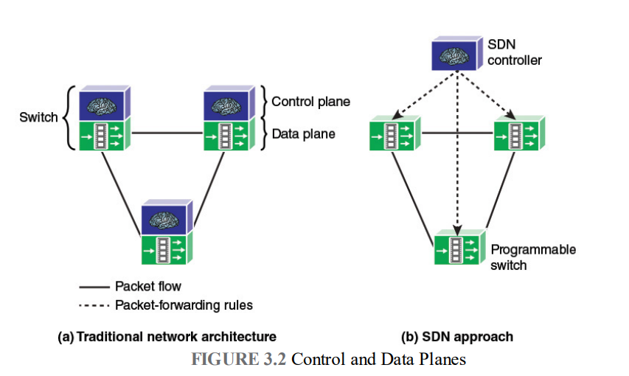
→ SDN Architecture
The SDN architecture consists of three main layers:
1. Data Plane (Infrastructure Layer):-
Consists of SDN enabled network devices (switches, routers) connected together forming the data/forwarding plane.
The data plane is responsible for forwarding packets from one network device to another based on the instructions provided by the control plane.
The Controller communicate with SDN devices over southbound interface.
2. Control Plane (SDN Controller):-
It acts as the “brain” of the network
Controllers offer a centralized view of the overall network
The control plane is responsible for making decisions about how data packets should be forwarded across the network.
It receives input from the application layer and translates it into rules for devices.
It enables real-time adjustments to network configurations based on traffic patterns, failures, or security threats.
In traditional networking, the control and data planes are tightly coupled within each device, leading to manual, device-specific configurations.
Notes:
in SDN, the control plane is centralized, and the data plane is simplified, enabling dynamic, automated, and efficient network management
A programmable switch in SDN is a network device that does not make independent decisions about packet forwarding. Instead, it relies on the centralized SDN controller
The software part of the network is separated from the hardware. The software decides how to route traffic through the network. This way, a centralized software interface controls the entire network. Otherwise, each device would need individual management.

Slide 18
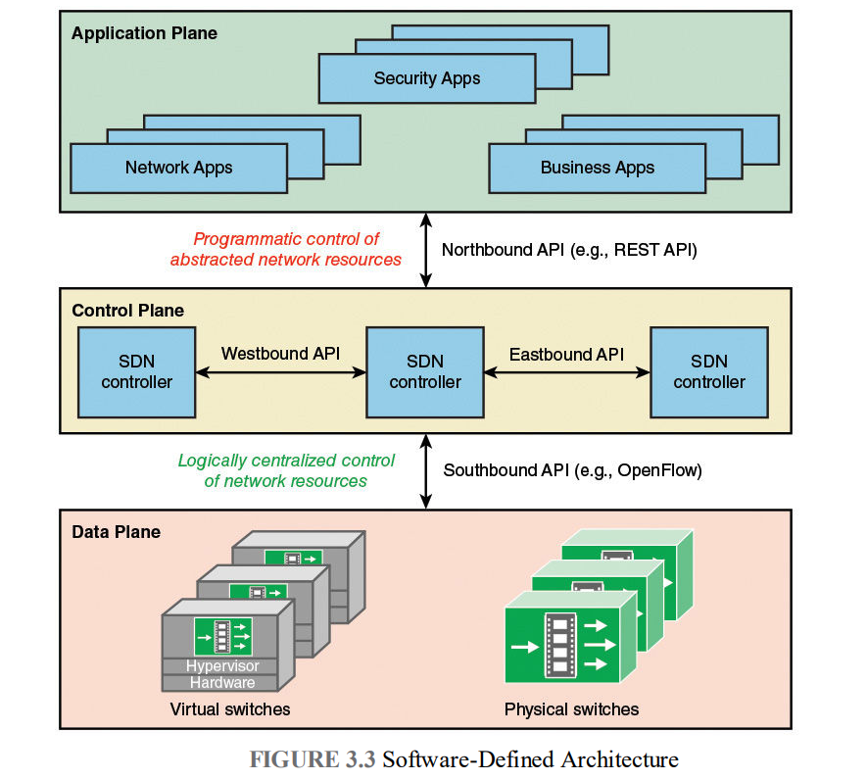
3. Application Plane:-
Those are programs that explicitly and directly communicate their network requirements to the SDN controller via a northbound interface(NBI).
This is where network applications live.
Examples: Traffic monitoring, firewalls, load balancers.
Northbound API:
Connects the Application Plane (top) to the Control Layer.
It allows applications to tell the SDN controller what they need from the network.
The controller uses this information to make smart decisions about how traffic is handled.
For example: A video streaming app might ask, “Can you give me high bandwidth for smooth streaming?”
Notes:
. Traffic System
Application Plane: City officials set high-level policies, like "reduce congestion during rush hours."
Control Plane: Traffic controllers or systems decide which roads should have longer green lights or detours.
Data Plane: Vehicles on the roads follow the traffic signals

Slide 19
Southbound API:
Connects the Control Plane to the Data Plane.
It’s how the controller sends instructions to the network devices.Common Protocol Ex-OpenFlow,NETCONF.
Example:The controller might say to a switch, “Forward all video traffic this way, and block this type of traffic.“
Eastbound API:
Communicate between SDN controllers within the same network domain.
Ensure smooth controller coordination
Example: If multiple SDN controllers manage different sections of a large data center, eastbound APIs allow them to exchange information.
Westbound API:
Communicate between SDN controllers across different network domains.
Supports inter-domain networking, allowing SDN controllers from different organizations to collaborate.
Example: If two telecom providers need to exchange routing information, westbound APIs facilitate this interaction.
Notes:
. Traffic System
Application Plane: City officials set high-level policies, like "reduce congestion during rush hours."
Control Plane: Traffic controllers or systems decide which roads should have longer green lights or detours.
Data Plane: Vehicles on the roads follow the traffic signal

Slide 20
SDN and NFV-Related Standards
SDN and NFV have a mix of organizations—standards bodies, industry consortia, and open-source initiatives—each contributing different parts.
NFV (Network Functions Virtualization):It refers to the process of replacing traditional hardware-based network devices (like firewalls, routers, and load balancers) with software-based versions that can run on standard servers.
1.Standards Organizations – They define official rules and terms
→ IETF (Internet Engineering Task Force)
Creates standards for how the internet works
Works on SDN things like routing and service paths
→ ITU-T (United Nations Telecom Group)
Defines SDN architecture and goals
Their key document is Y.3300 and it focuses on mobile, cloud, and multimedia networks
Active Study Groups (SGs):
→ SG13 – Leads SDN work (focus on cloud, mobile, next-gen networks)
→ SG11 – Works on SDN signaling and IPv6
→ SG15 – Focus on transport and access networks
→ SG16 – Multimedia and OpenFlow for virtual content delivery

Slide 21
→ ETSI (European Standards Group)
Leading role in NFV standards and created NFV Industry Specification Group (ISG NFV) in 2013
Published 11 core documents covering: NFV architecture , Infrastructure , Quality of service (QoS) , Orchestration , Security and resilience
2. Industry Consortia
These are private groups formed by companies to speed up development:
→ Open Networking Foundation (ONF)
Main organization for SDN standards
Created and maintains the OpenFlow protocol
Promotes SDN adoption through open, vendor-neutral standards
→ Open Data Center Alliance (ODCA)
A global group defining requirements for cloud infrastructure using SDN and NFV
→ ATIS (Alliance for Telecommunications Industry Solutions)
A consortium providing standards and best practices
Has explored how SDN/NFV impact operational processes and network programmability
Notes:
Network programmability refers to the ability to configure, monitor, and manage network devices and services using software and APIs (Application Programming Interfaces), rather than relying on manual configurations. It allows networks to be more dynamic, automated, and responsive to changing demands

Slide 22
3. Open Development Initiatives
These are community-driven, open-source projects:
→ OpenDaylight
An open source project under the Linux Foundation
Builds a modular SDN controller with: Southbound interfaces, Northbound APIs, Network services and apps
Major versions: Hydrogen (2014), Helium (late 2014)
→ Open Platform for NFV (OPNFV)
Builds real-world NFV platforms using open-source tools
Makes sure NFV systems work well together
→ OpenStack (Neutron)
A cloud platform that provides Network-as-a-Service (NaaS)
Integrates with SDN controllers to enable advanced network functions and topologies.

Slide 23
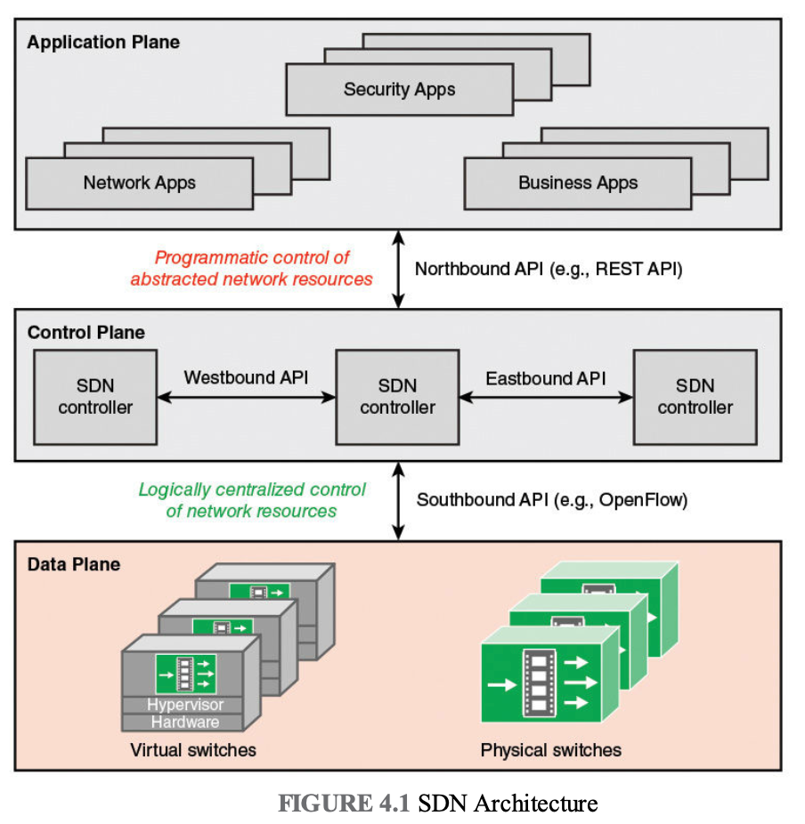
SDN Data Plane
:
Think of the data plane as the part of the network that actually moves your data around.
This layer has the network devices like routers and switches.
These devices follow instructions given to them by the "brain" of the network (the SDN control plane).
The devices in this layer are designed to be simple and just forward data.
They don't have built-in "intelligence" to make their own routing decisions.
Another name for this layer is the "resource layer" or the "infrastructure layer."

Slide 24
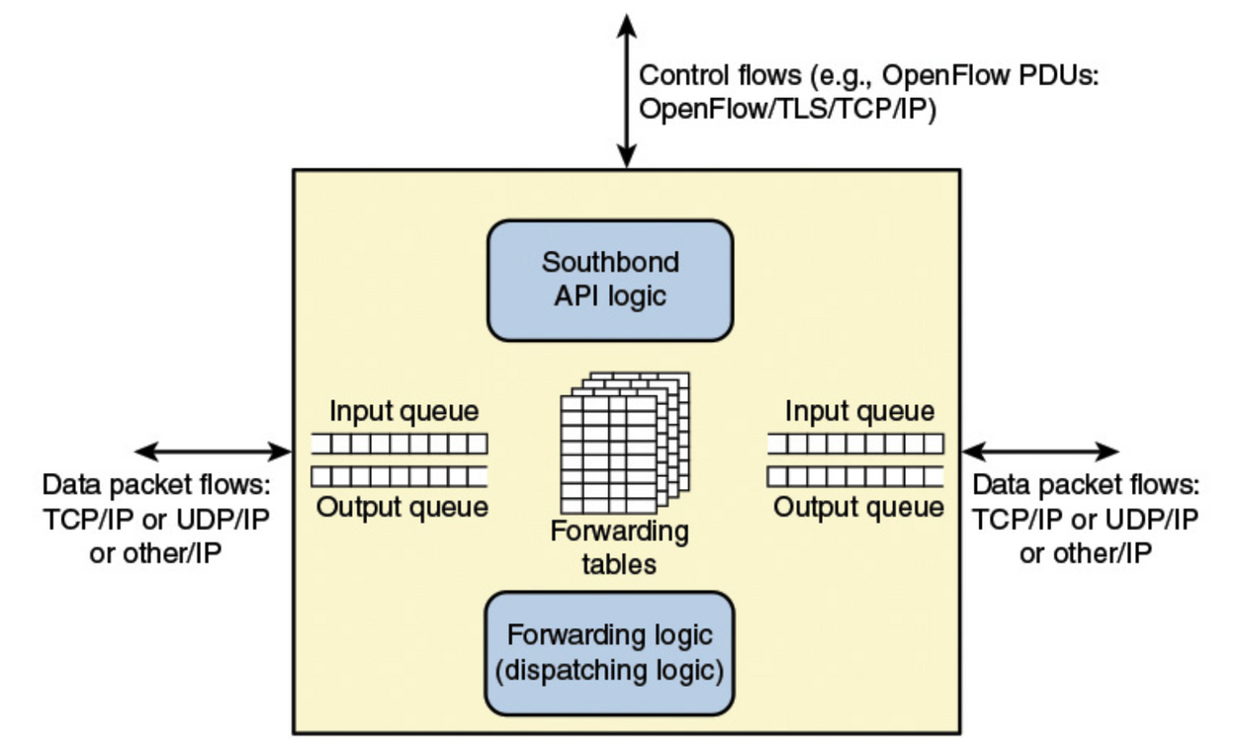
→ Functions of Data Plane Devices
Control Support Function:
This lets the network device (like a switch or router) talk to the main controller (the "brain").
Think of it as a way for the device to receive instructions.
Data Forwarding Function:
This is the main job of the device.
It involves moving data packets to where they need to go.
It can also involve changing the data packets or even discarding them, all based on rules from the controller.
The figure shows a simple device with three connections.
One connection is for talking to the controller (control communication).
Two connections are for data to come in and go out.
Real devices can have many more connections for both control and data.
A device might even talk to more than one controller.

Slide 25
→ Data Plane Protocols
Data Flows and IP Packets:
The actual data being transmitted travels as streams of IP packets.
Looking Deeper into Packets:
Network devices might need to look not just at the main IP address information.
They might also need to check information in the "upper-level" parts of the packet, like TCP or UDP (which help manage connections and send specific types of data).
This allows for more specific rules on how to handle different kinds of traffic.
Making Forwarding Decisions:
The network device looks at the IP address in each packet.
It might also look at other information in the packet's "headers."
Based on this information and the rules it has, it decides where to send the packet next.

Slide 26
Control Communication (Southbound API):
Besides the regular data traffic, there's another important type of communication.
This happens through a "southbound API."
Think of this as the language the controller uses to talk to the network devices.
OpenFlow is a common example of a protocol used for this communication.
This control traffic is how the controller tells the data plane devices what to do.

Slide 27
OpenFlow Logical Network Device
Making SDN Practical: To really make SDN work, two key things are needed:
A Common Way of Thinking: All the network devices (switches, routers, etc.) need to look and act like a single, standard type of switch to the SDN controller. It shouldn't matter what brand or specific hardware they are.
A Standard Way to Talk: There needs to be a secure and agreed-upon language for the SDN controller to communicate with these network devices.
OpenFlow to the Rescue: OpenFlow solves both of these problems.
It's a Protocol: It's the language the SDN controller uses to tell the network devices what to do.
It's a Blueprint: It also defines how a network switch should logically work, so all devices appear the same to the controller.
The OpenFlow Specification: This blueprint and protocol are described in detail in a document called the "OpenFlow Switch Specification," which is created by the Open Networking Foundation (ONF).

Slide 28
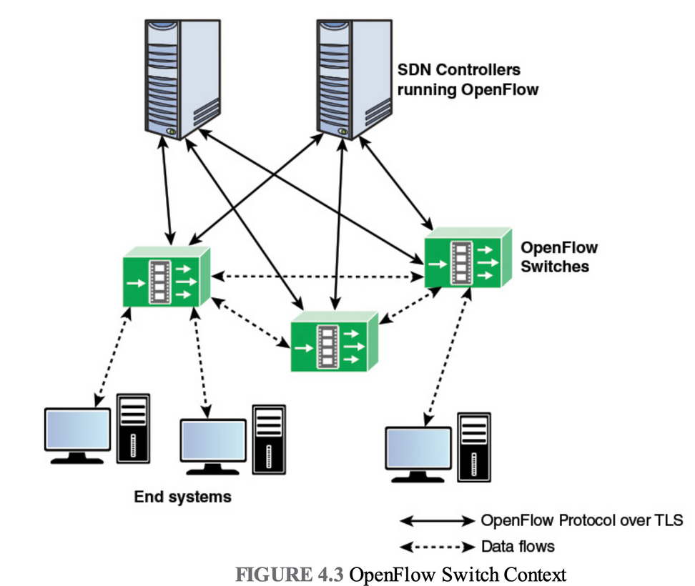
→OpenFlow Environment and Architecture
Figure displays the main components of an OpenFlow switch. An SDN controller communicates with OpenFlow-compatible switches using the OpenFlow protocol running over Transport Layer Security (TLS).
Each switch connects to other OpenFlow switches and, possibly, to end-user devices that are the sources and destinations of packet flows.
On the switch side, the interface is known as an OpenFlow channel. These connections are via OpenFlow ports.
An OpenFlow port also connects the switch to the SDN controller.

Slide 29
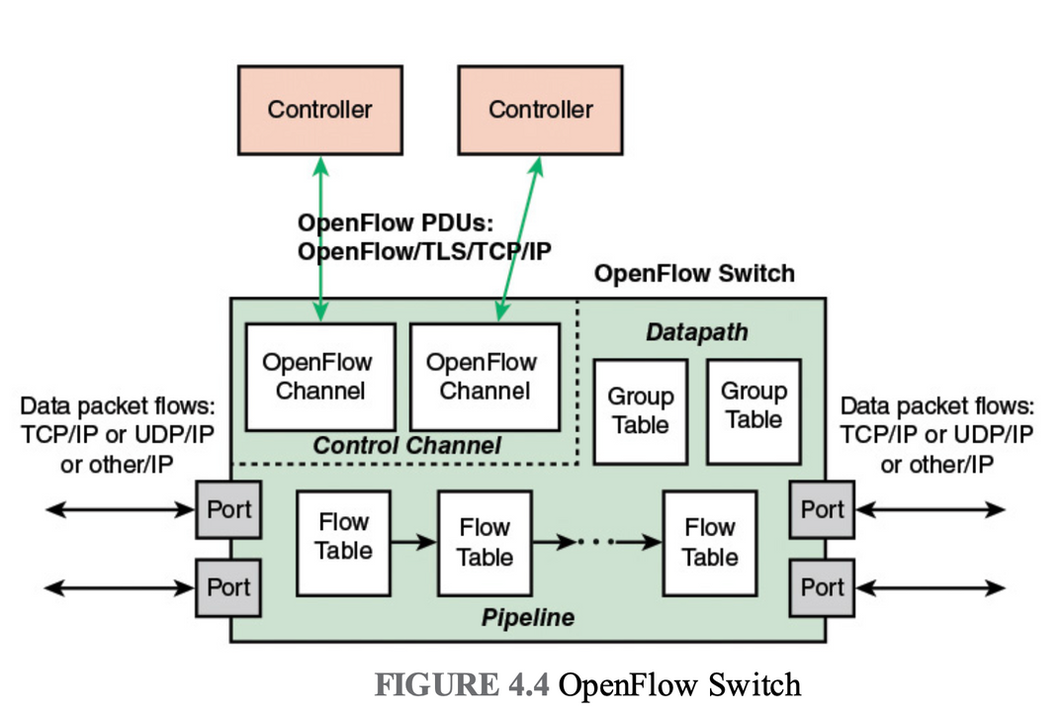
→Main Components of OpenFlow Switch
OpenFlow Ports: Physical connections for data and controller communication.
OpenFlow Channel: Secure (TLS) link for controller-switch communication.
Connectivity: Connects to other switches and end devices.
OpenFlow Protocol: Implemented for controller interaction.
TLS Support: Ensures secure communication.
Physical Port: Directly maps to a hardware interface on the switch (e.g., an Ethernet port).
Logical Port: An abstract port not directly tied to hardware. It can represent things like aggregated links, tunnels, or loopback interfaces. Its internal workings are hidden from OpenFlow, and it interacts with OpenFlow like a physical port.

Slide 30
.
Reserved port: Defined by the OpenFlow specification. It specifies generic forwarding actions such as sending to and receiving from the controller, flooding, or forwarding using non-OpenFlow methods, such as “normal” switch processing.
→ Flow Tables
OpenFlow switches use multiple types of tables to manage the flow of packets through the network.The OpenFlow specification defines three types of tables in the logical switch architecture.
Flow Tables (Packet Matching and Actions)
Match incoming packets based on set rules (like IP addresses, port numbers).
Define actions for matched packets (e.g., forward, drop, send to controller).
Core part of packet handling in the switch.
2. Group Tables (Actions for Multiple Flows)
Allow actions to be applied to groups of flows.
Support more advanced behaviors (like load balancing, multicasting, failover).
Useful for handling multiple packets the same way.

Slide 31
3. Meter Tables (Performance Management)
Manage performance and traffic control.
Apply rate-limiting to control how fast packets are sent.
Help implement Quality of Service (QoS) by monitoring traffic usage.
Flow Entry Management:
The SDN controller can:
Add, update, or delete entries in these tables.
Do it reactively (in response to incoming packets).
Or proactively (in advance, based on expected traffic).

Slide 32
Understanding "Flows":
While the OpenFlow specification doesn't have a rigid definition, a "flow" is generally understood as a stream of network packets that share a common set of characteristics identified in their headers.
For example, all packets belonging to a specific TCP connection between two servers would constitute a flow because they would likely have the same source and destination IP addresses and port numbers.
The flow tables use these header fields to identify and act upon these streams of packets.

Slide 33
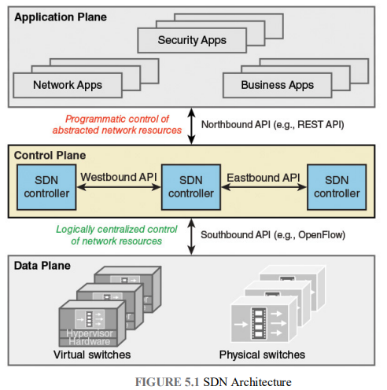
SDN Control Plane Architecture
The SDN control layer translates application service requests into commands for data plane switches.
It provides applications with data on network topology and activity.
Implemented as a server or group of servers called SDN controllers.

Slide 34
→Control Plane Functions
Shortest path forwarding: Uses routing information collected from switches to establish preferred routes.
Notification manager: Receives, processes, and forwards to an application events, such as security alarms, and state changes.
Security mechanisms: Provides isolation and security enforcement between applications and services.
Topology manager: Builds and maintains switch interconnection topology information.
Statistics manager: Collects data on traffic through the switches.
Device manager: Configures switch parameters and attributes and manages flow tables.

Slide 35
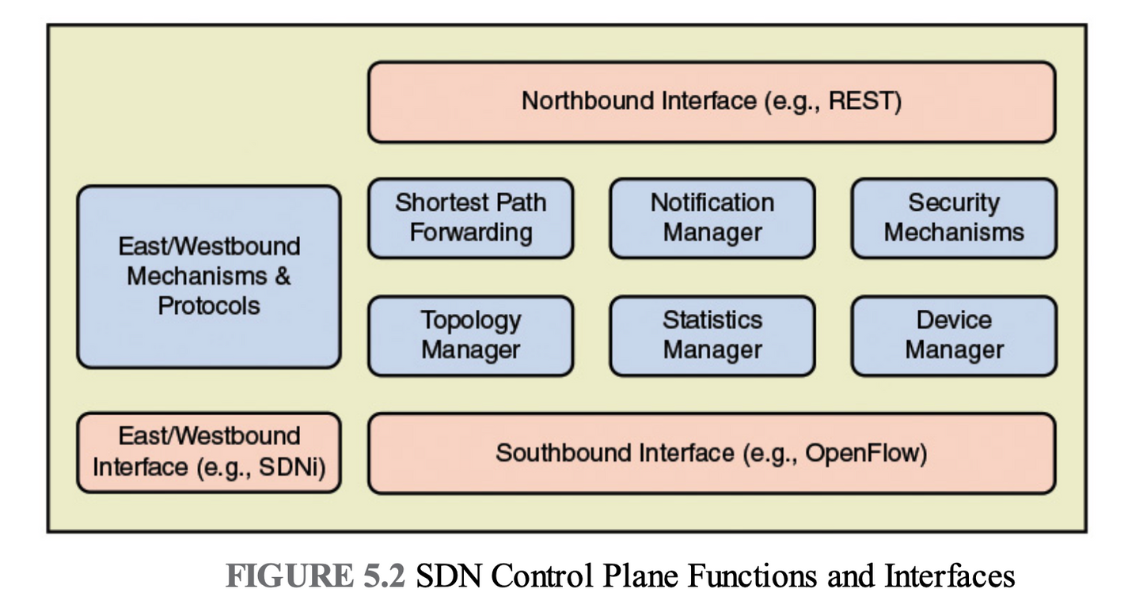

Slide 36
→ SDN Controller as a Network Operating System (NOS)
An SDN controller functions like a network operating system (NOS), offering centralized control and network service management.
It abstracts physical network complexity, creating a unified platform for applications across diverse hardware.
It offers:
→ Standardized APIs for programming network behavior.
→ Abstraction layer hiding device-specific details.
→ Policy enforcement tools (e.g., routing, access control, QoS).
This abstraction helps manage heterogeneous networks with changing configurations.

Slide 37
→ Prominent SDN Controller Implementation
1.OpenDaylight: Open-source Java-based platform by Cisco and IBM. Supports both centralized cand distributed deployments; widely backed by network vendors.
2.ONOS (Open Network Operating System): Open source, carrier-funded (e.g., AT&T, NTT), supported by ONF. Designed for distributed control and provides abstractions for partitioning and distributing network state onto multiple distributed controllers.
3.POX: Python-based controller with a simple API and web GUI. Ideal for experimentation and rapid development.
4.Beacon: Java-based, developed at Stanford. Early beginner-friendly SDN controller, integrated with Eclipse IDE.
5.Floodlight: Open source, built from Beacon. Uses Apache Ant, features REST API, web and Java GUIs, and strong community support.
6.Ryu: Python-based modular SDN framework by NTT Labs. Easy to extend and customize.

Slide 38
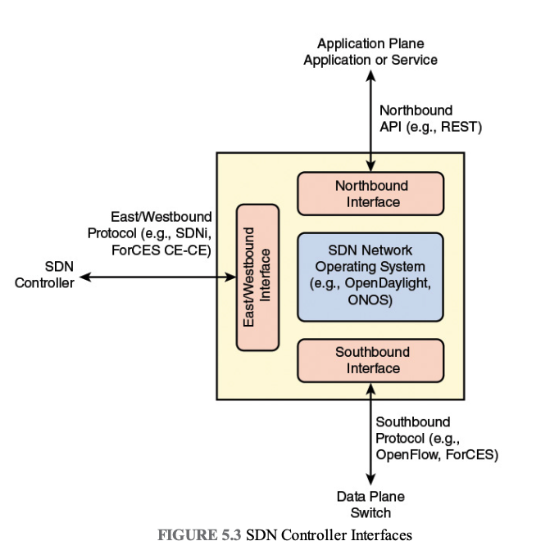
→ Southbound Interface in SDN
The southbound interface serves as the communication link between the SDN controller (control plane) and the data plane switches .Some SDN controllers support only one specific southbound protocol, but a more flexible approach is to use a southbound abstraction layer, which offers a unified control interface while supporting multiple southbound APIs.The most commonly implemented southbound API is OpenFlow.

Slide 39
→ Other southbound interfaces include the following:
OVSDB (Open vSwitch Database Management Protocol):Used for managing and configuring Open vSwitch (OVS), a software-based virtual switch that supports most hypervisors. OVS uses OpenFlow for forwarding, while OVSDB handles management tasks.
ForCES (Forwarding and Control Element Separation):An IETF standard that defines the interaction between the control and data planes in IP routers.
POF (Protocol Oblivious Forwarding):An advanced form of OpenFlow. Instead of understanding specific protocol headers, it uses (offset, length)matching blocks within packets, pushing the protocol intelligence to the controller, simplifying the data plane logic.

Slide 40
→ Northbound Interface in SDN
The northbound interface (NBI) allows applications and network administrators to interact with the SDN controller without needing to understand the low-level details of network devices. It provides access to control plane functions through software APIs, rather than defined protocols.
Lack of Standardization:
No universal NBI standard, leading to incompatible APIs across SDN controllers and harder app portability.
API Latitudes Concept:
NBIs exist in layers:
Low-level: close to controller functions.
High-level: support analytics, services, and app logic.

Slide 41
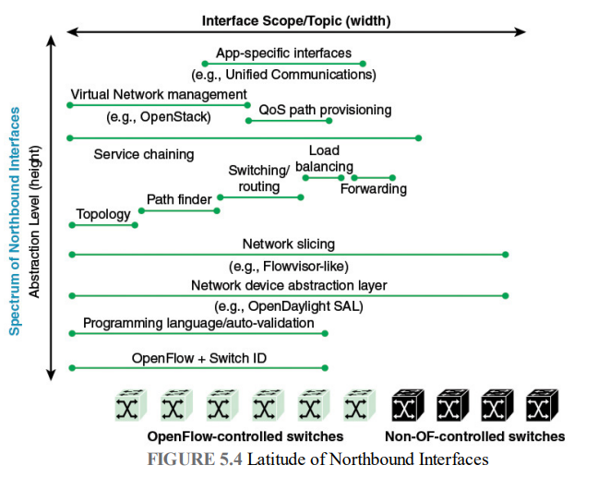

Slide 42
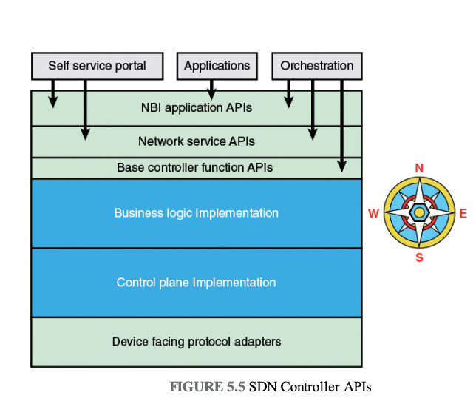
SDN Controller APIs
Base controller function APIs:
These APIs expose the basic functions
of the controller and are used by developers
to create network services.
Network service APIs:
These APIs expose network services to the
north.
Northbound interface application APIs:
These APIs exposes application-related services that are built
on top of network services.

Slide 43
Routing in SDN Networks
Just like traditional networks, Software-Defined Networking (SDN) requires routing to determine how data travels through the network.
Routing involves two main components:
A protocol for discovering network topology and traffic conditions.
An algorithm to compute optimal paths through the network.
→ SDN vs Traditional Routing:
In traditional networks, routing is distributed—each router builds and maintains its own view of the network.
In SDN, routing is centralized in the SDN controller, which:
Has a global, consistent view of the network.
Implements smarter, application-aware routing policies.
Offloads routing computation and storage from the switches, improving performance.

Slide 44
→ Centralized Routing in SDN:
.The SDN controller includes a routing application with two main roles:
Link Discovery:
Identifies connections between:
Switches (Layer 2 physical links)
Routers and hosts
Routers in different network domains
(Triggered by unknown traffic from hosts or external routers)
Topology Manager:
Maintains up-to-date topology information.
Calculates shortest paths between:
Data plane switches
Switches and host systems

Slide 45
Thank You

